Slide 1


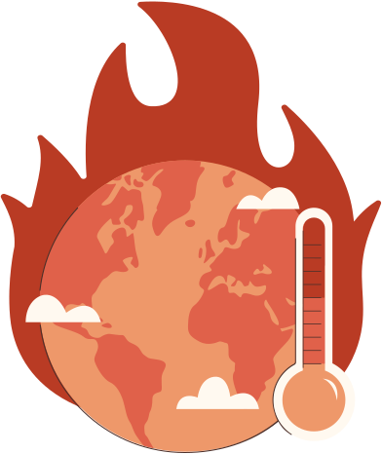

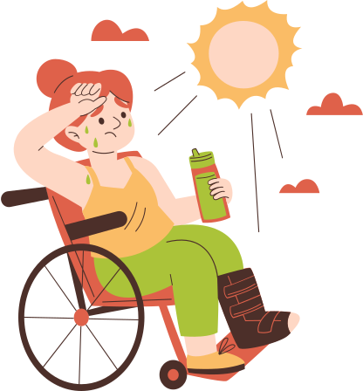
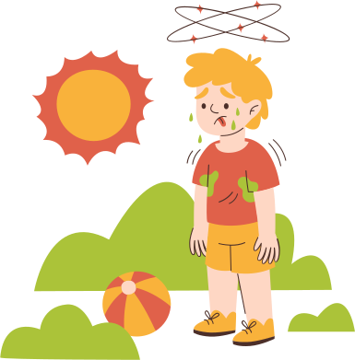
CLIMATE, WEALTH & HEALTH
PRESENTED BY:
aDRITA
RIDHHI
SANIYA

Slide 2






INTRODUCTION
CO₂ emissions and public health are closely connected to development.
We wanted to understand whether higher emissions are linked to different health outcomes.
We studied four outcomes: air pollution, malaria, life expectancy, and cholera.
We combined WHO and World Bank data with CO₂, population, and economic indicators.
We compared countries across income groups and over time.

Slide 3






data sets used
WHO: Health indicators — air pollution, malaria, life expectancy & cholera
World Bank: Population, GDP per capita & income group
CO₂ dataset: Country-level CO₂ emissions
Data was cleaned, merged and standardized for comparison
Final analysis used country-level observations and removed regional/income aggregates

Slide 4

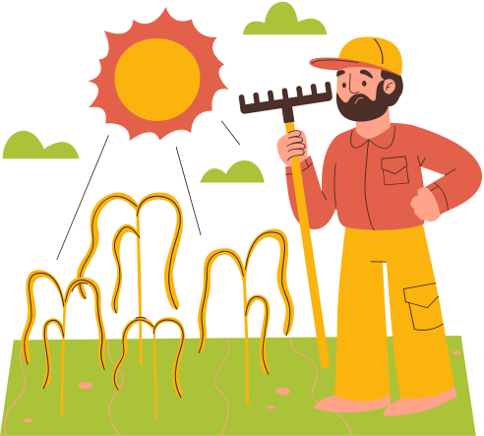

We Started With a Simple Question
first Attempt
We explored how CO₂ emissions relate to population health.
We focused on four outcomes: air pollution, malaria, life expectancy, and cholera.
We combined health, emissions, population, and economic data.
Our starting question: Do countries with higher CO₂ emissions show different health outcomes?

Slide 5







The First Number That Made Us Pause
We began by checking whether the datasets could be merged into one complete country-year table.
The first complete-data check returned 0 rows across all four health indicators.
Data availability varied sharply by outcome:
Malaria + CO₂: 2,651 observations
Life expectancy + CO₂: 3,982 observations
Cholera + CO₂: 213 observations
Air pollution + CO₂: 181 observations
This raised our first question: Were we actually working with comparable and reliable data?

Slide 6


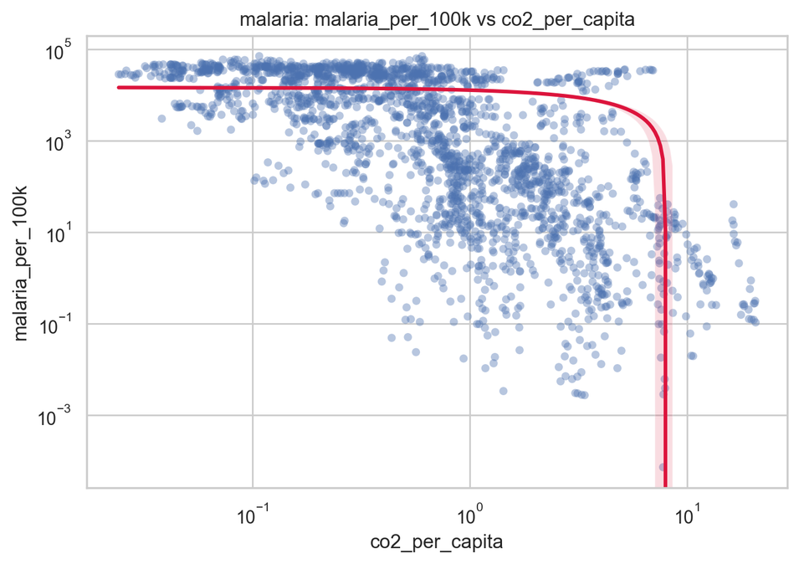
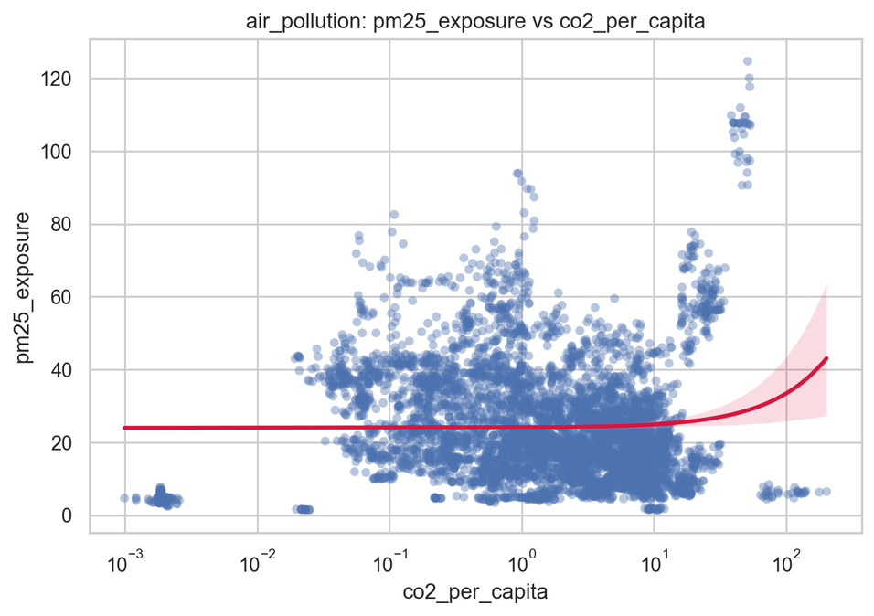


The Graph Made the Problem Visible
The initial CO₂–health graphs showed unexpected patterns and extreme values.
Some values were far too large or suspiciously uniform.
The results made us question whether the issue was with the data, the calculations, or both.
Before interpreting the relationships, we needed to investigate the underlying variables.

Slide 7





What Was Actually Going Wrong?
Data Preparation Challenges
Data restructuring: WHO & World Bank data had to be cleaned and filtered at the country level.
Indicator issues: Discontinued cholera data and limited air-pollution data required replacements.
Calculation error: Population was incorrectly taken from the CO₂ dataset, affecting per-capita values.
Comparability: Data was standardized into per-100k health rates and per-capita CO₂, with GDP and income group added for context.

Slide 8




We Fixed the Data Before Trusting the Results
Data Preparation Process
Filtered datasets to country-level data
Reshaped World Bank data: wide → long
Created 4 outcome-specific datasets
Replaced discontinued cholera and air-pollution indicators
Fixed the population-data error
Standardized health outcomes to per 100k and CO₂ to per capita
Added GDP per capita and income group for comparison

Slide 9



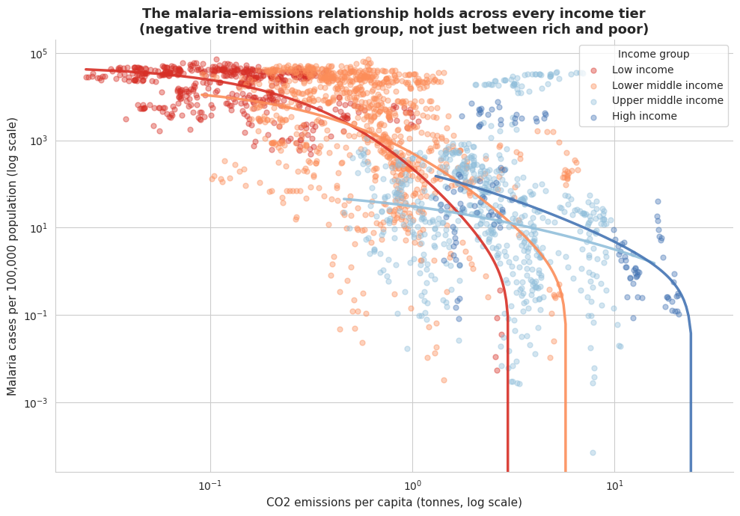

The Same Question. A Different Graph.
Recalculated using correct population data
Standardized health rates & CO₂ per capita
Replaced unsuitable indicators and removed aggregates
Re-ran the analysis on corrected data
Used the corrected results for reliable interpretation

Slide 10



One Relationship, Three Ways to Test It
Analysis Approach
Examined CO₂ vs. 4 health outcomes
Compared all countries and income groups
Studied within-country changes over time
Controlled for GDP per capita
Compared methods to identify consistent patterns and confounding effects

Slide 11


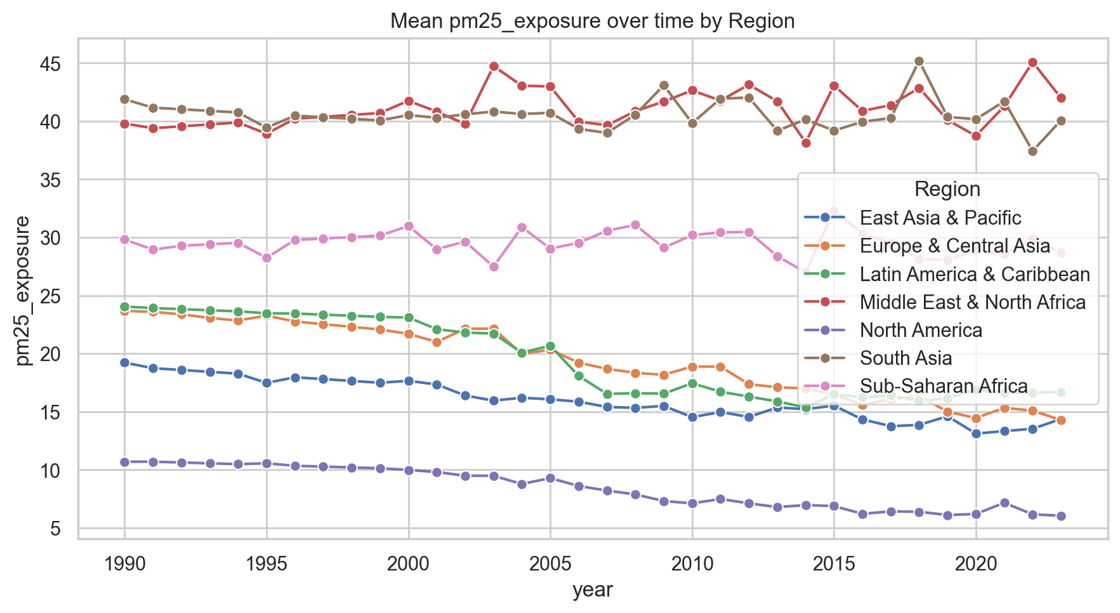
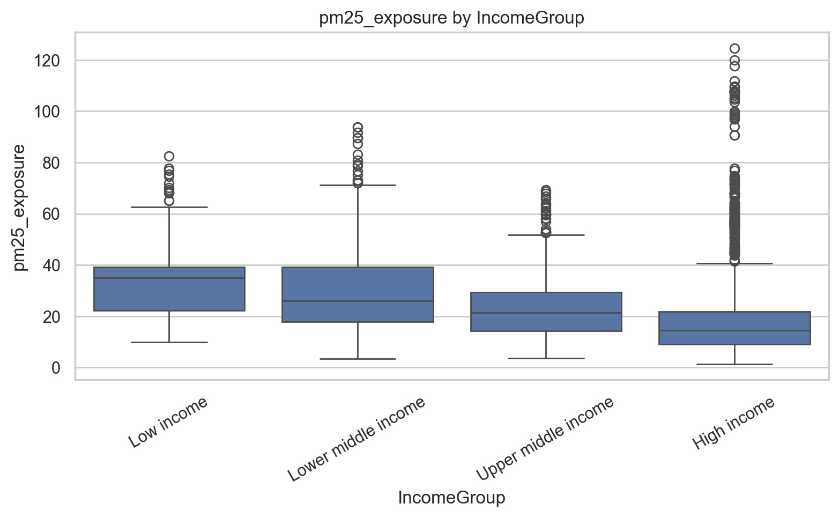
The Result We Expected to Be Strongest Was the Weakest
The relationship changes over time and differs by region. Some regions decline, while others remain high or fluctuate.
PM2.5 exposure differs substantially across income groups. Lower-income groups generally have higher exposure, while high-income countries have lower typical exposure—but with many outliers.

Slide 12
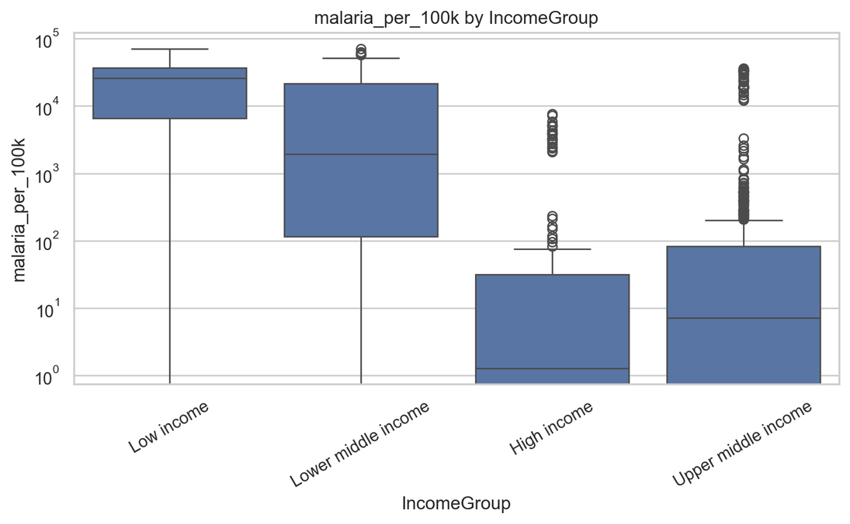
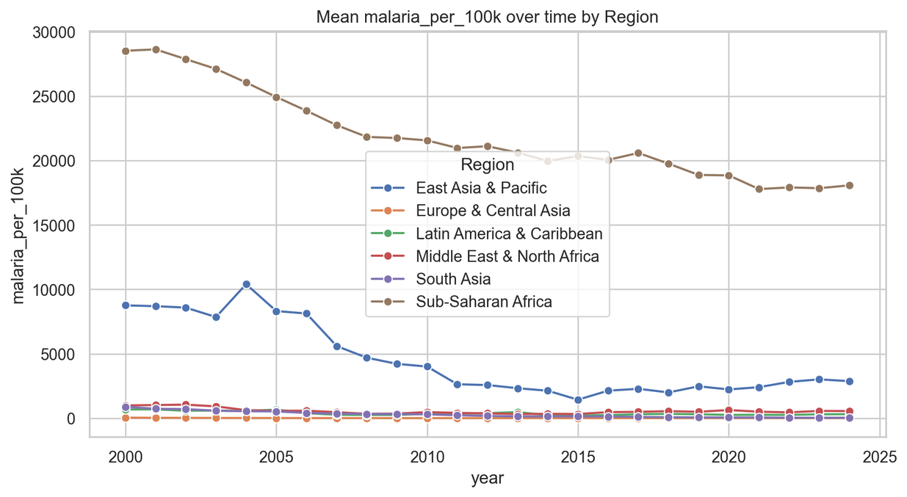
The Relationship That Survived Every Test
How malaria rates are distributed across the four income groups. Compare medians, spread, and outliers.
How malaria rates change over time across regions. Look for whether the pattern is broadly consistent or differs by region.

Slide 13
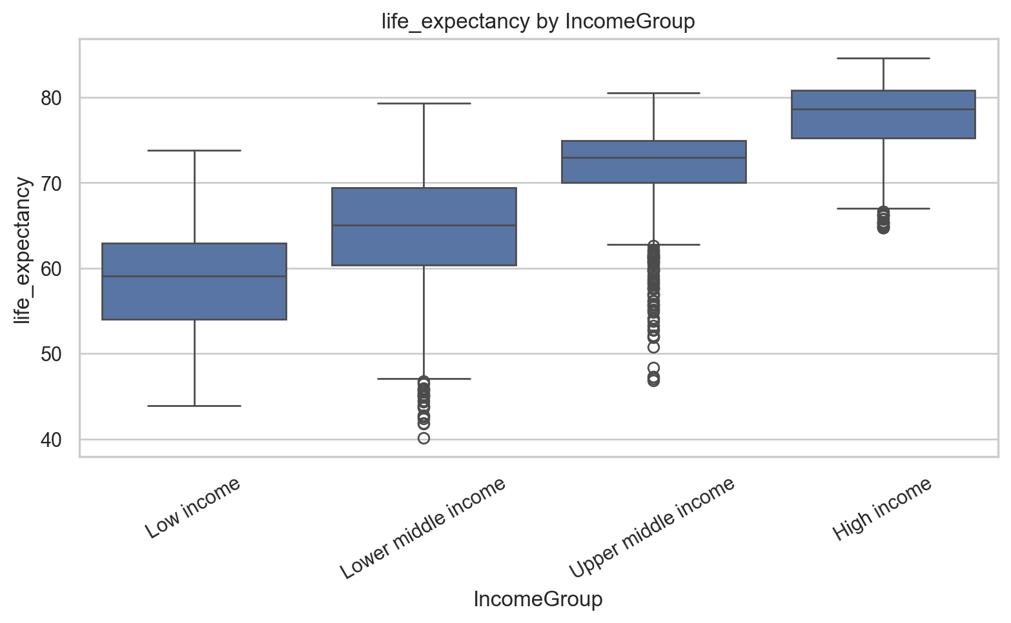
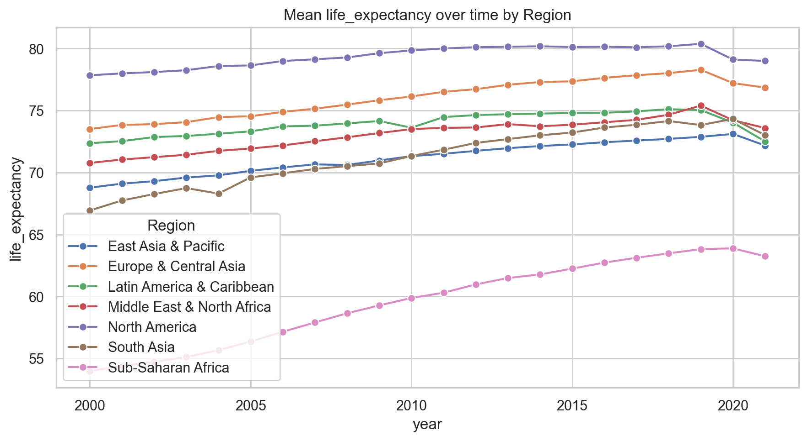
A Strong Correlation, But Not the Whole Story
Higher-income countries generally had higher life expectancy.
CO₂ and life expectancy showed a strong positive correlation.
After controlling for wealth, the relationship became much weaker.

Slide 14
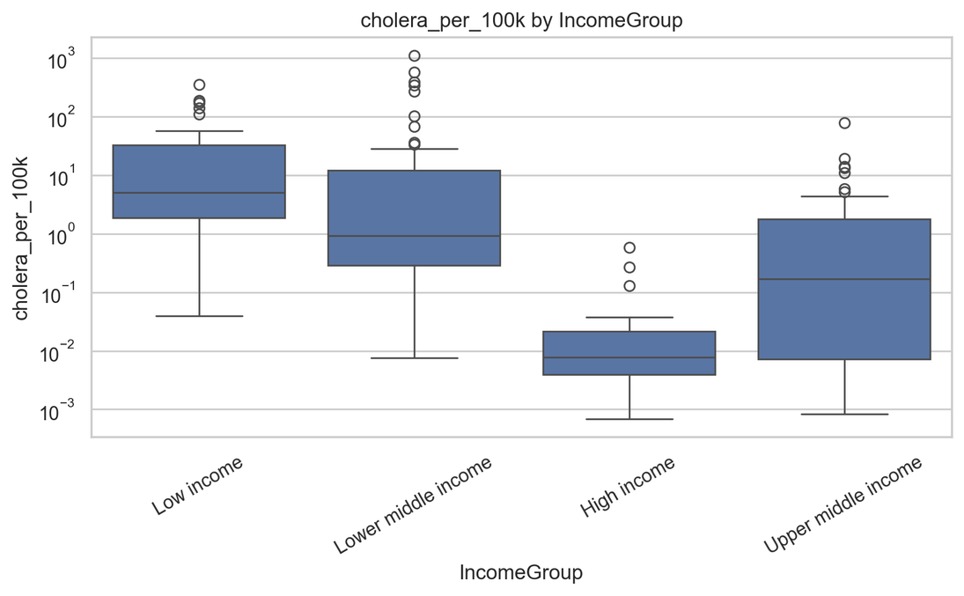
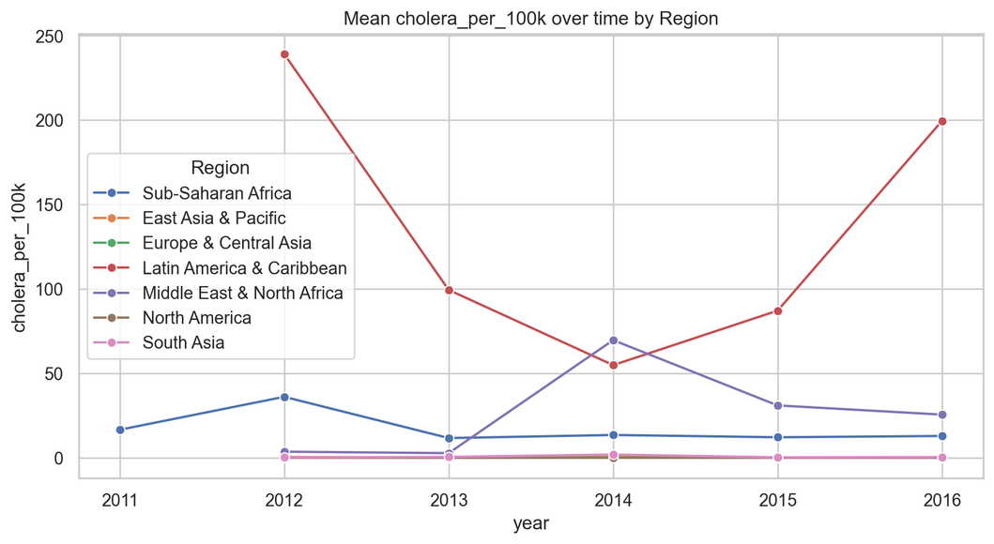
When a Significant Result Isn't the Whole Truth
CO₂ appeared significant in the cholera regression, while GDP did not.
CO₂ and GDP were highly correlated, creating multicollinearity.
Therefore, statistical significance did not prove that CO₂ directly affected cholera.

Slide 15

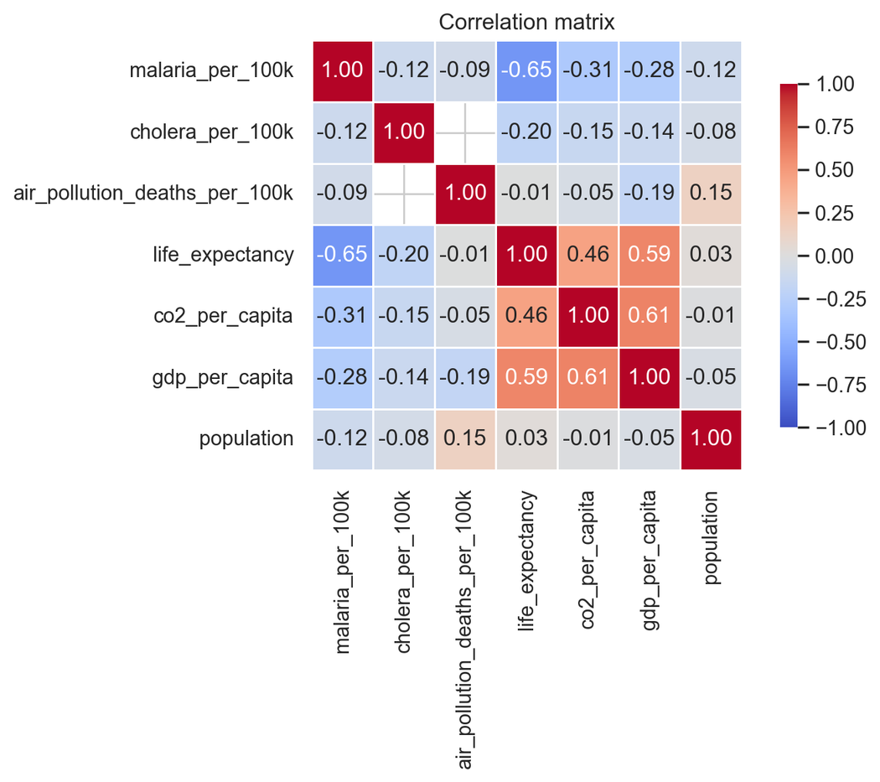
OLD CORRELATION HEAT MAP
Original values: Malaria −0.74, life expectancy +0.74, cholera −0.70, and air pollution −0.24 in the corrected heatmap; the old heatmap showed different patterns because it used a different method and older data.
Main issue: It used standard correlation on raw values, while the rest of the analysis used a rank-based, skew-resistant correlation method.
Data problem: It still used the old single-year air pollution mortality variable instead of the corrected yearly PM2.5 exposure variable.

Slide 16

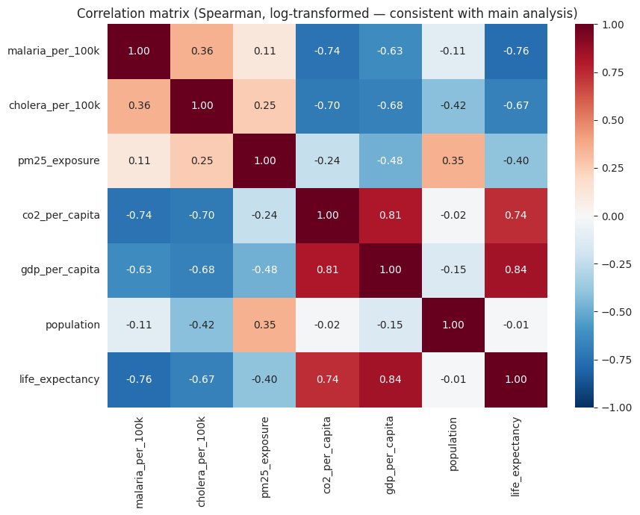
When the Data and the Method Finally Agreed
Rebuilt the heatmap using the corrected data and the same statistical method used throughout the analysis.
The results aligned with the findings from the income-group and time-trend analyses.
Malaria: Strong negative relationship with CO₂ (−0.74).
Life expectancy: Strong positive relationship with CO₂ (+0.74).
Cholera: Strong negative relationship with CO₂ (−0.70).
Air pollution: Much weaker relationship (−0.24).
The heatmap confirmed the pattern—but did not establish causation.

Slide 17

We Started by Studying Emissions. We Ended Up Understanding Development.
We started by studying the relationship between CO₂ emissions and health.
Our analysis showed that CO₂ alone cannot explain health outcomes.
Economic development, income, and other factors also shape these outcomes.
Patterns varied across countries and income groups.
Using corrected and comparable data made our findings more reliable.
We started by studying emissions. We ended up understanding development.

Slide 18






Thank
you
https://github.com/SaniyaShaikh-sxc/climate-health-lifestyle-analysis

